Slide 1
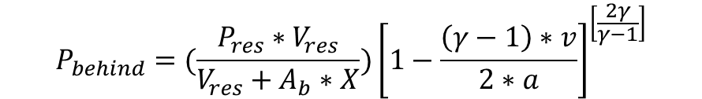





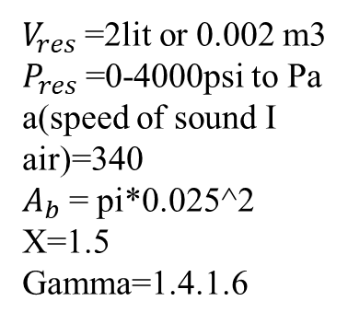

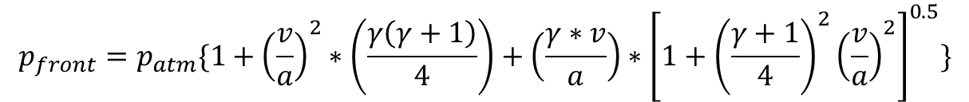
$$P_{res}$$
mt=mp+ms
$$P_{behind}$$
Area of barrel
$$P_{front}$$
$$A_{b}$$
$$V_{res}$$
X=1.5
X=0
$$\frac{dv}{dt}=\frac{A_{b}}{m_{t}}∗\left(P_{behind}−P_{front}\right)$$
$V_{res}$ =2lit or 0.002 m3
$P_{res}$=0-4000psi to Pa
a(speed of sound I air)=340
$A_{b}$= pi*0.025^2
X=1.5
Gamma=1.4.1.6
----1
$$P_{behind}=(\frac{P_{res}∗V_{res}}{V_{res}+A_{b}∗X}{)\left[1−\frac{\left(γ−1\right)∗v}{2∗a}\right]}^{\left[\frac{2γ}{γ−1}\right]}$$
----2
$$p_{front}=p_{atm}\{1+{\left(\frac{v}{a}\right)}^{2}∗\left(\frac{γ\left(γ+1\right)}{4}\right)+\left(\frac{γ∗v}{a}\right)∗{\left[1+{\left(\frac{γ+1}{4}\right)}^{2}{\left(\frac{v}{a}\right)}^{2}\right]}^{0.5}\}$$
----3
Sub (2) and (3) in (1) and solved( 1) for displacement and velocity at small iterations of time t=1e-6, The initial conditions of displacement and velocity are taken zero using ODE45 in MATLAB

